Slide 1
Repeated Measures ANOVA
Lecture 17
Notes:
https://www.youtube.com/watch?v=6jfXBtN25u4
https://statistics.laerd.com/spss-tutorials/one-way-anova-repeated-measures-using-spss-statistics.php

Slide 2
The difference between a regular one-way ANOVA and a repeated measures ANOVA
A regular one-way analysis of variance (ANOVA) is used to determine if there are statistically significant differences between the means of two or more unrelated groups
A repeated measures analysis of variance (ANOVA) is used to determine if there are statistically significant differences between the means of two or more related groups.
Repeated measures ANOVAs should be used when your data has the following qualities
  One independent, categorical variable that has two or more levels (or groups) received by all participants and one continuous dependent variable
  OR one continuous dependent variable assessed at two or more times with all participants being assessed at each time

Slide 3
Examples
One DV at multiple times: Participants’ symptoms are measured before the intervention (time 1), after the intervention (time 2), and for a 6 week follow-up (time 3)
One categorical IV with two or more levels and one continuous DV: Participants’ comprehension is measured after receiving a lecture from instructor A, instructor B, and instructor C ← counterbalancing may be important

Slide 4
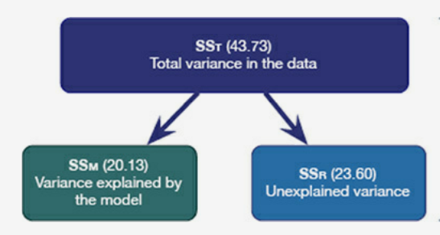
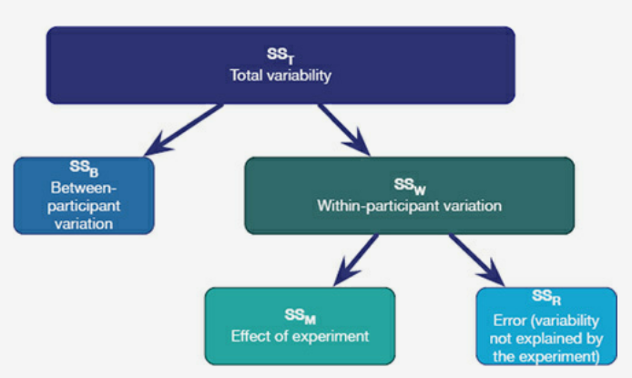
How variance is partitioned
Regular one-way ANOVA
Repeated measures ANOVA
Notes:
Field, Andy. Discovering Statistics Using IBM SPSS Statistics . SAGE Publications. Kindle Edition.

Slide 5
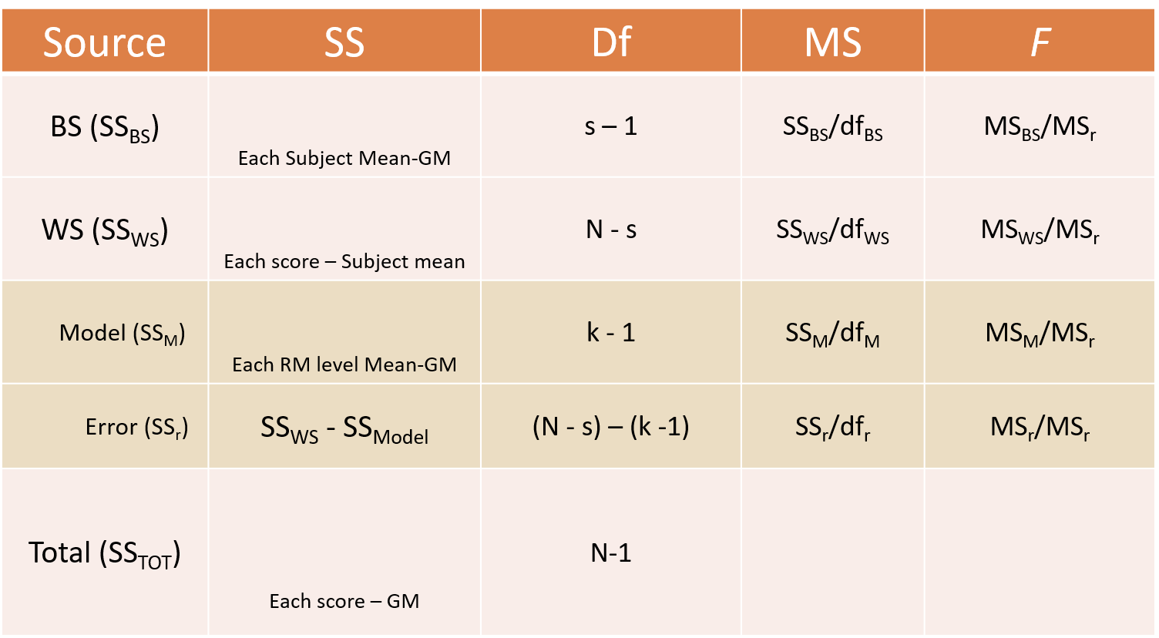




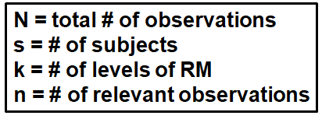
ANOVA table for a repeated measures ANOVA
Notes:
SS Total- – Take each score and subtract grand mean from it, then square that value, and add them all up.
You will NOT be tested on this but for those who want to see the method behind the madness of RMANOVA….here you go!
SS bs- Take each subject mean and subtract grand mean from it, square it, then take that value and multiply it by the number of things that went into that mean (should = k). Do that for every person then add them all together
SS ws- Take each score and subtract subject mean from it, then square it. Do that for each score then add them all together.
SS model- Take each RM level mean and subtract grand mean from it, then square it. Multiply that number by the number of people that contributed to each mean (should = s). Do that for each RM level mean then add them all together.
SS ws- SSWS minus SSModel

Slide 6
Between-subjects and within-subjects
Between-subjects studies (each group gets one condition)
  Minimizes the learning and transfer across conditions
  Have shorter sessions than within-subject studies
Within-subjects studies (each participant gets all conditions)
  Require fewer participants and can be cheaper to conduct
  Minimize random noise (because each participant is their own control)

Slide 7
Advantages and disadvantages
Advantages
  Less noise
  Smaller sample size
  Can tell if people improve or get worse after an intervention
Disadvantages
  May be missing a control group (depending on the design)
  Practice effects occur when some people improve because they’ve completed a measure before
  Fatigue effects occur when some people get worse because they’ve completed several tasks.measures without a break
  Order effects occur when the order of conditions somehow impacts people’s responses

Slide 8
Can we just use standard ANOVA with repeated measures data?
No, Independent Measures (standard) ANOVA assumes the data are independent.
Data from a repeated measures experiment are not independent

Slide 9
Assumptions
Linearity requires that the IV linearly affect the DV (the relationship looks like a line without any bends)
Each person gets each condition
  Replaces the independence assumption
  Some degree of missing data can be estimated
Normally distributed residuals requires that the error (or unique variance) has a normal distribution (a bell curve or a normal curve)
Sphericity requires that the relationship between pairs of experimental conditions is similar (i.e., the level of dependence between experimental conditions is roughly equal)
  Replaces the homogeneity of variance assumption

Slide 10
In-class demonstration

Slide 11
Example
We want to know how participants’ ratings of model attractiveness differ based on which part of the model’s face they see.
Variables
  DV: attractiveness rating from 1 to 10
  Condition: eyes, full, mouth
Hypothesis: Participants will rate models’ full faces as more attractive than either the eyes or the mouth.
Notes:
I’ve made this hypothesis up. I’m not sure where the data came from, but it seems like it is best suited for a mixed ANOVA. I “modified” how we’re analyzing the data to fit a repeated measures ANOVA.

Slide 12
How to complete a repeated measures ANOVA in JASP
Open the data (female.csv)
How to compare condition means
  Click on “Descriptives”
  Click on “Descriptive Statistics”
  Move the DVs into “Variables”
  Leave everything else the same
How to test whether any differences are significant
  Click on “ANOVA”
  Click on “Repeated Measures ANOVA”
  Under “Repeated Measures Factors” add “Level 3”
  Move DVs into “Repeated Measures Cells”

Slide 13
How to complete a repeated measures ANOVA in JASP
How to test the assumption of sphericity
  In the same tab, under “Assumption Checks” click on “Sphericity tests”
  Under “Assumption Checks” click on “Sphericity corrections” and “None”, “Greenhouse-Geisser,” and “Huynh-Feldt”
  This should be non-significant. Significance means that the variances are significantly different and we’ve violated the assumption of sphericity.
  If Mauchly’s test is significant, use either the Greehouse-Geisser correction or the Huynh-Feldt correction.
  Notice the F-table changes (adds corrections)
    Use GG when the estimate is less than .75
    Use HF when the estimate is greater than .75

Slide 14
How to complete a repeated measures ANOVA in JASP
How to follow-up a significant F-test with post hoc tests
  Do NOT do this unless the F-test is significant
  Under “Post Hoc Tests” move “RM Factor 1” over into the box on the right
  Under “Correction” click on “Bonferroni” and unclick “Holm”

Slide 15
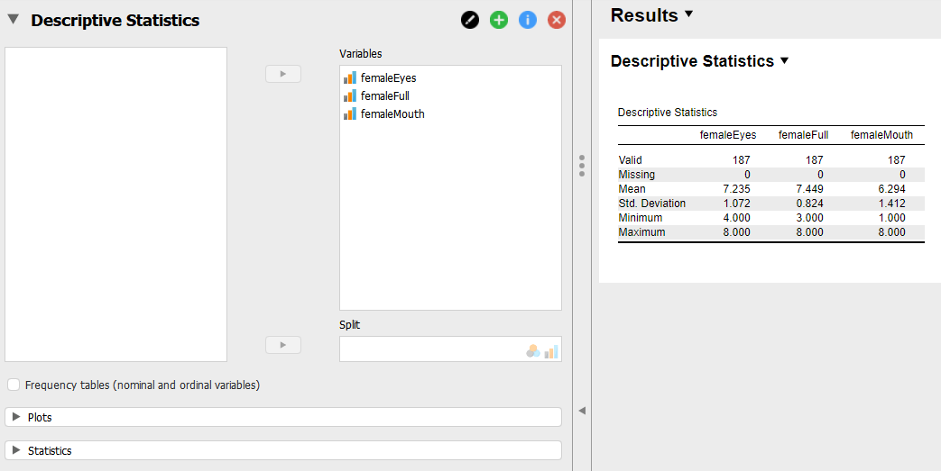
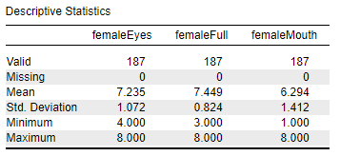
How to compare condition means

Slide 16
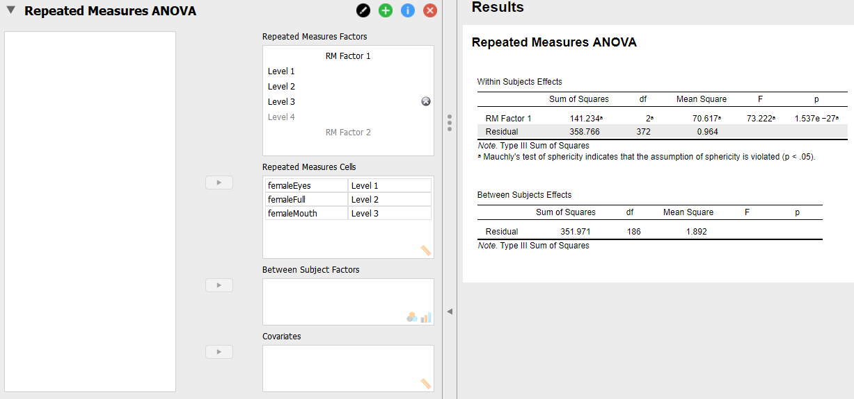
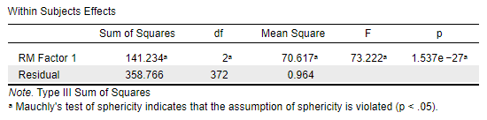
How to test whether any differences are significant

Slide 17
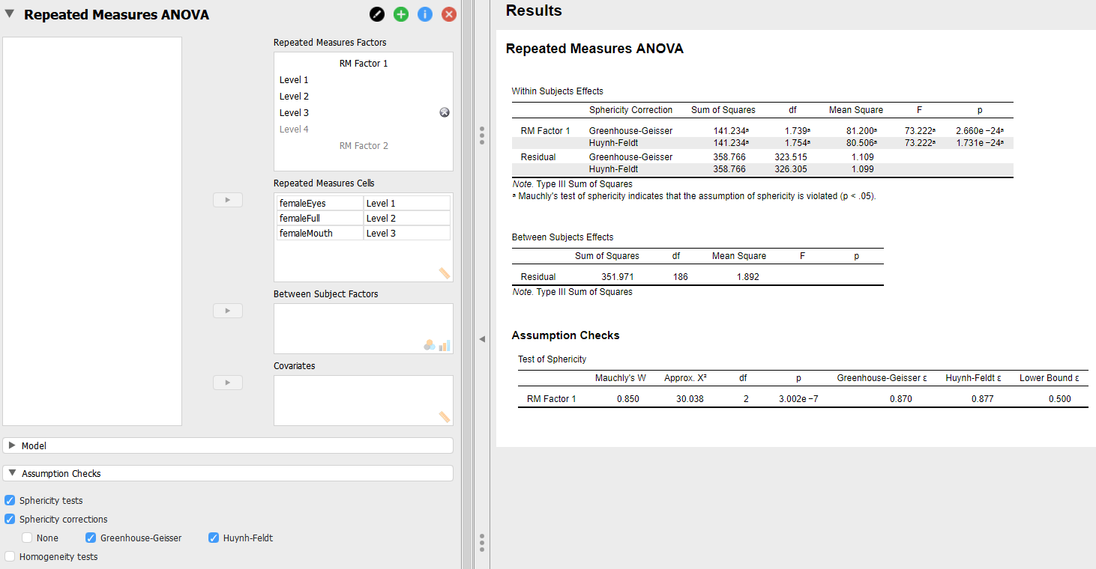
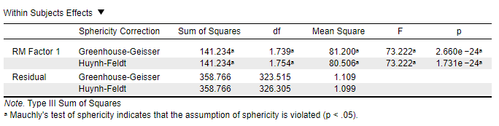
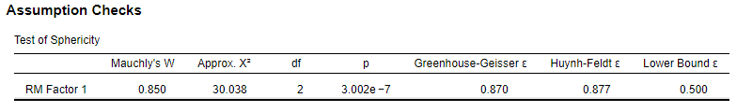
How to test the assumption of sphericity

Slide 18
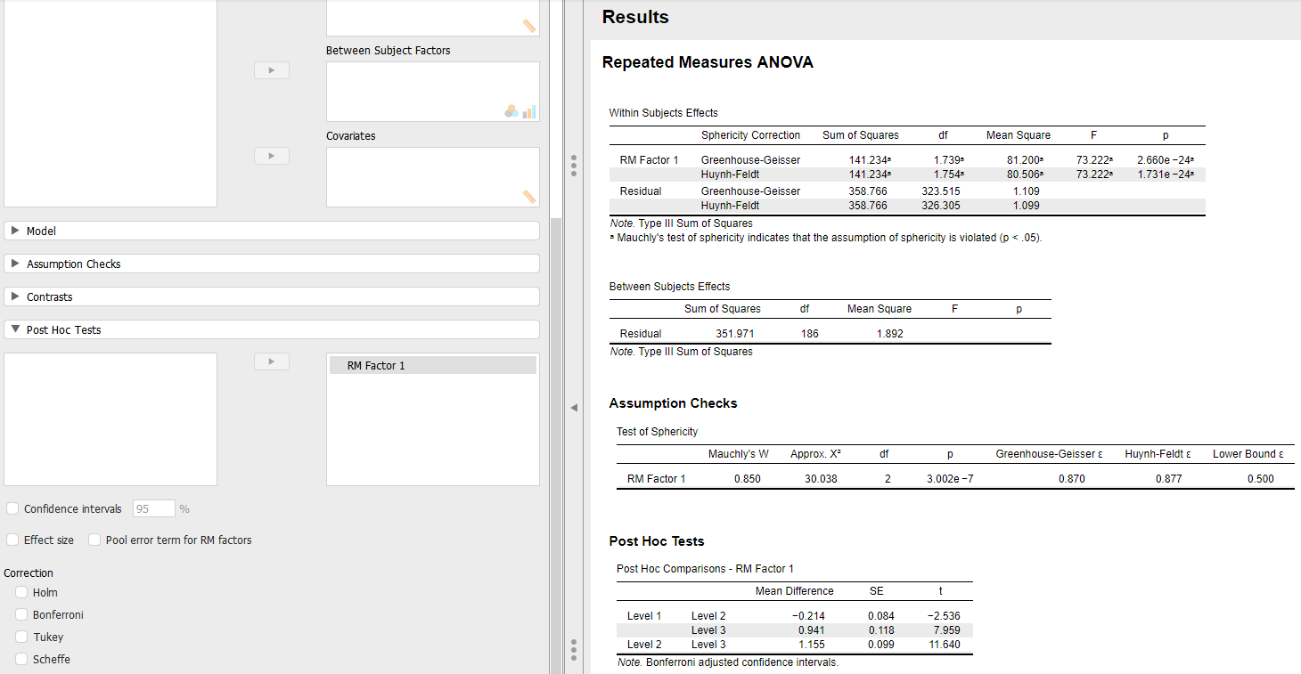
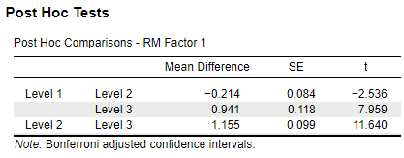
How to follow-up a significant F-test with post hoc tests

Slide 19
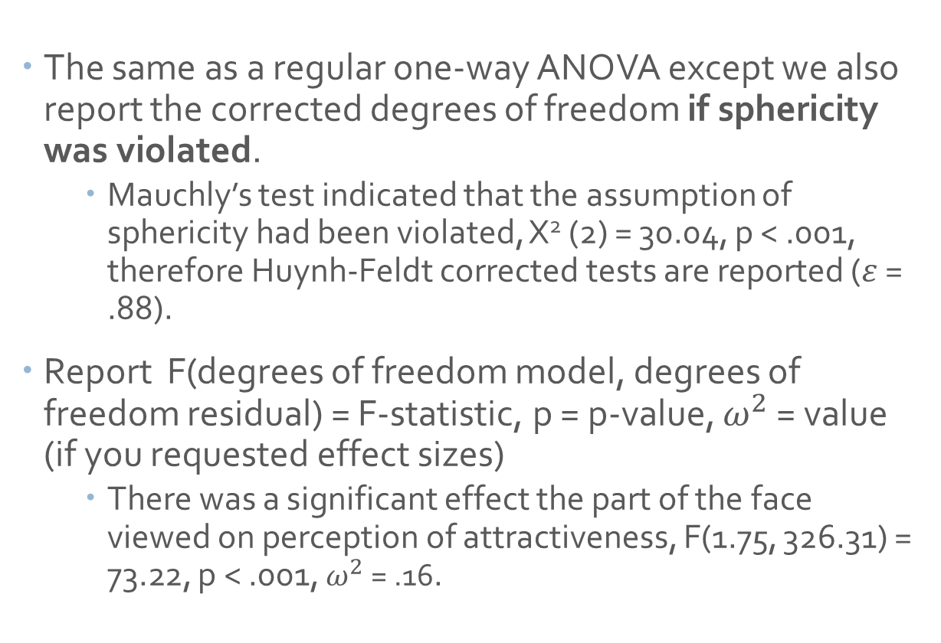
How to report results for a one-way ANOVA
The same as a regular one-way ANOVA except we also report the corrected degrees of freedom if sphericity was violated.
  Mauchly’s test indicated that the assumption of sphericity had been violated, X² (2) = 30.04, p < .001, therefore Huynh-Feldt corrected tests are reported ($ε$ = .88).
Report F(degrees of freedom model, degrees of freedom residual) = F-statistic, p = p-value, $ω^{2}$ = value (if you requested effect sizes)
  There was a significant effect the part of the face viewed on perception of attractiveness, F(1.75, 326.31) = 73.22, p < .001, $ω^{2}$ = .16.

Slide 20
How to report results for a one-way ANOVA
For post hoc tests, report t(degrees of freedom) = t-statistic, p = p-value.
  Post hoc tests revealed that perceptions of attractiveness were significantly lower for those viewing the eyes (M = 7.235, SD = 1.07) compared to those viewing the full face (M = 7.45, SD = 0.82), t(373) = -2.54, p = .04. Perceptions of attractiveness were significantly higher for those viewing the eyes (M = 7.235, SD = 1.07) compared to those viewing the mouth (M = 6.29, SD = 1.41), t(373) = 7.96, p < .001. Perceptions of attractiveness were significantly higher for those viewing the full face (M = 7.45, SD = 0.82) compared to those viewing the mouth (M = 6.29, SD = 1.41), t(373) = 11.64, p < .001.

Slide 21
It’s your turn!

Slide 22
In-class assignment
Use “male.csv”
Run descriptive analyses (without boxplots) to look at the group average scores
Test whether there are significant group differences with a repeated measures ANOVA
Be sure to test the assumption of sphericity and use the appropriate correction if necessary
If there are significant group differences, use post hoc tests to determine which groups are significantly different from each other
Take screenshots of these analyses and paste them into a Word document
Report your results in APA format below the screenshots
Submit your Word document on Blackboard. This is a group activity, so only one of you need to submit the activity.

